Slide 1
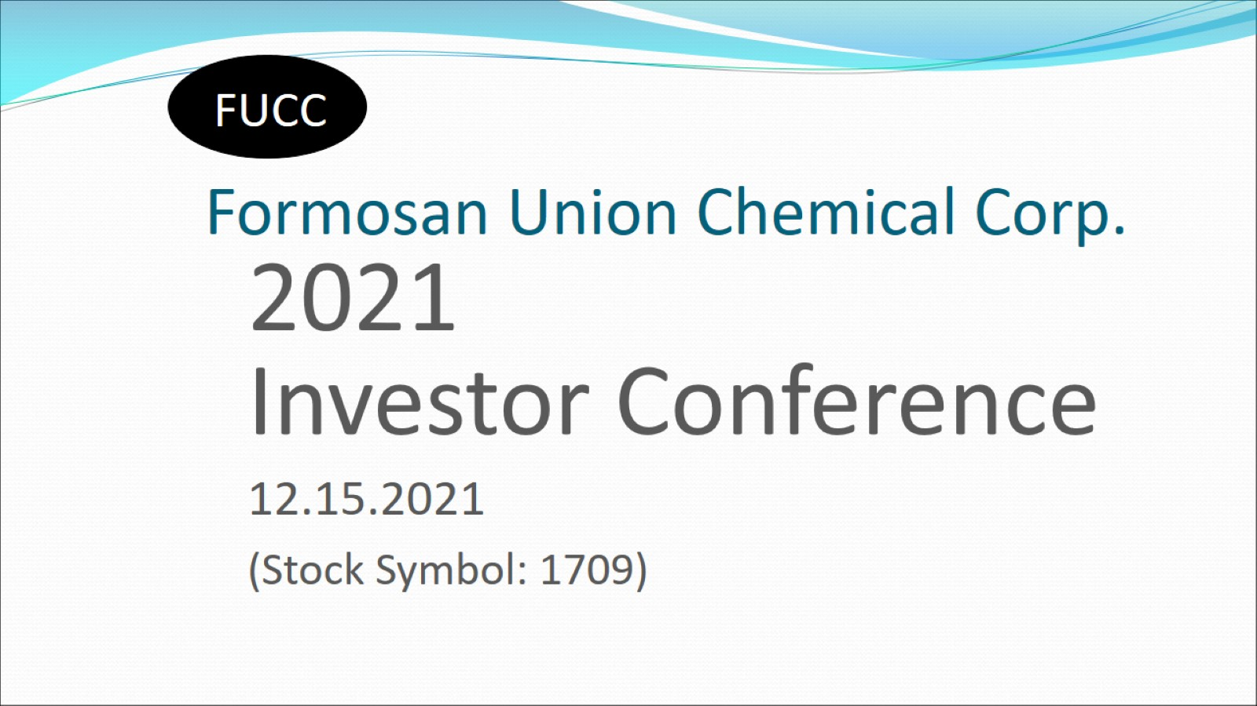
Formosan Union Chemical Corp.

Slide 2
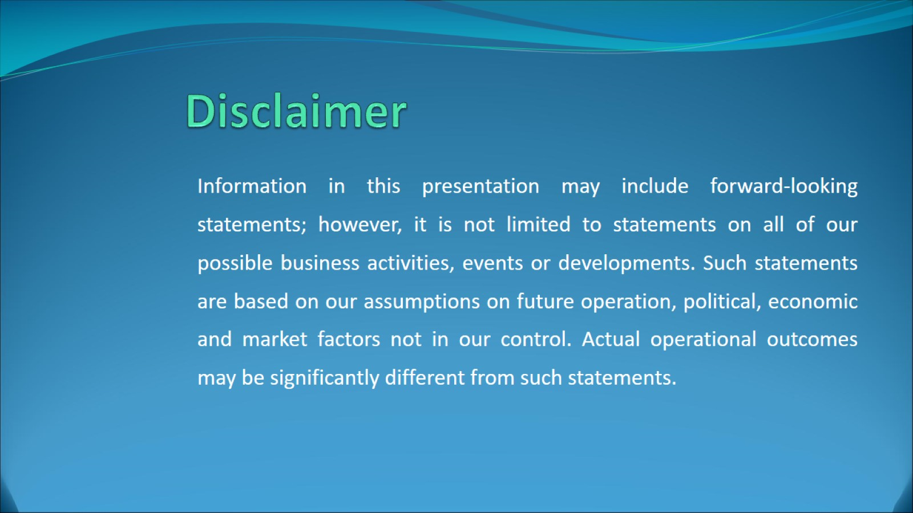
Disclaimer

Slide 3
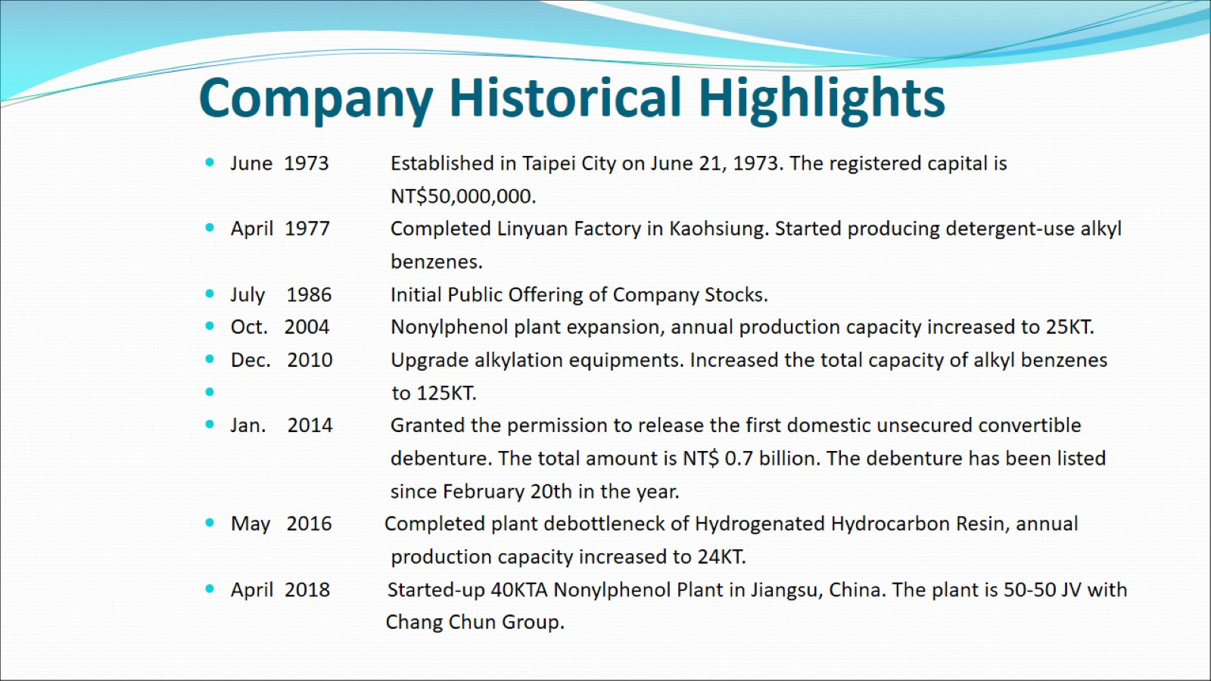
Company Historical Highlights

Slide 4
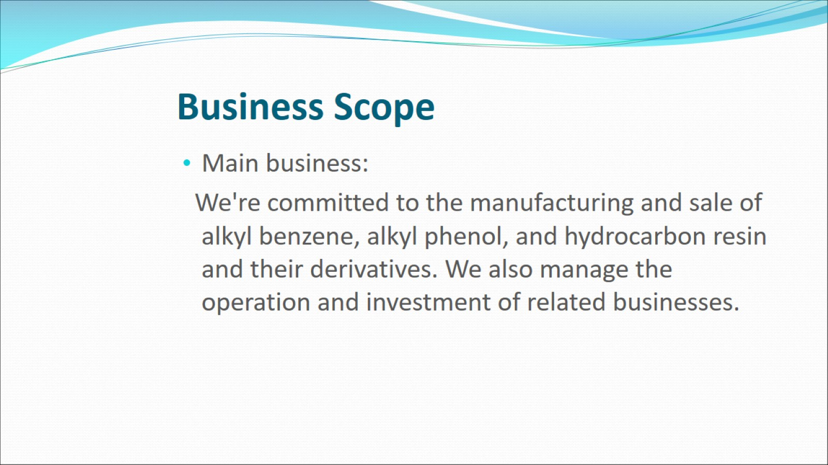
Business Scope

Slide 5
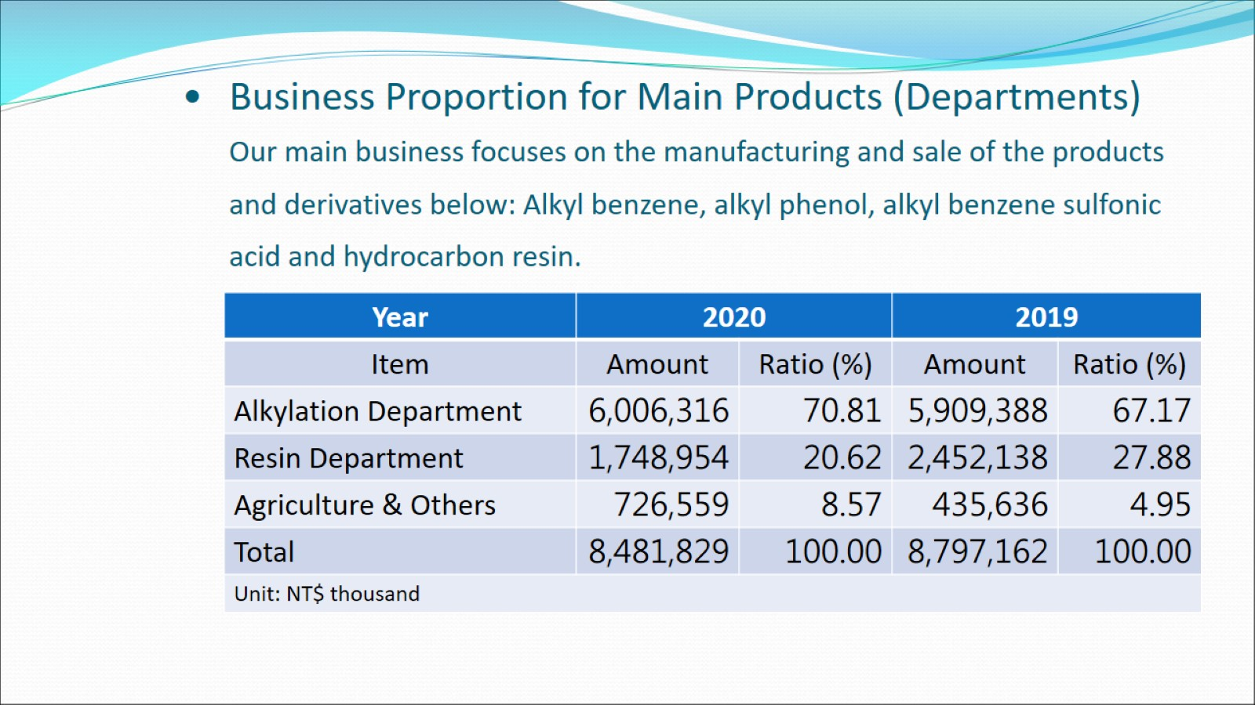
Business Proportion for Main Products (Departments)
Our main business focuses on the manufacturing and sale of the products and derivatives below: Alkyl benzene, alkyl phenol, alkyl benzene sulfonic acid and hydrocarbon resin.

Slide 6
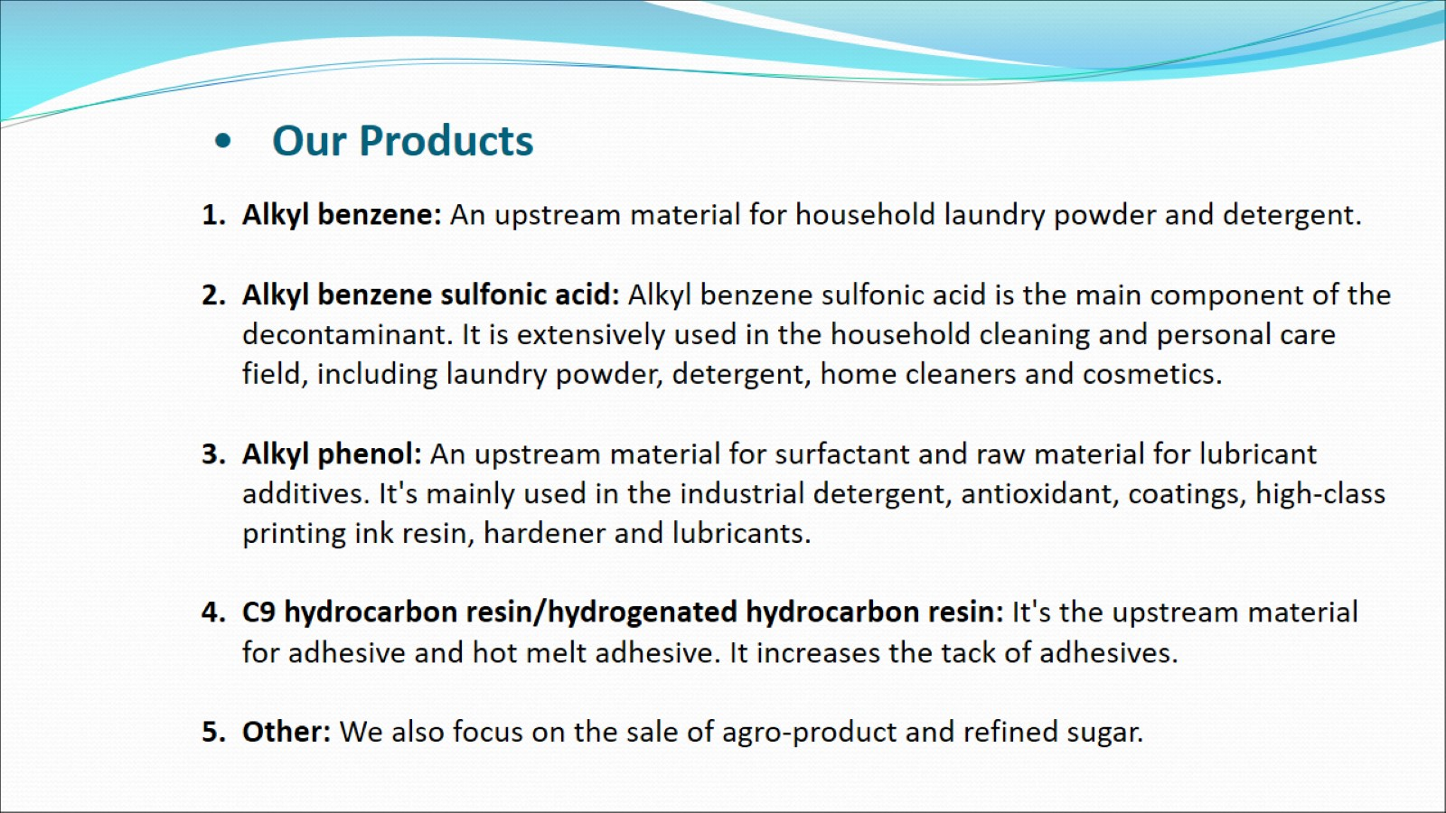
Our Products

Slide 7
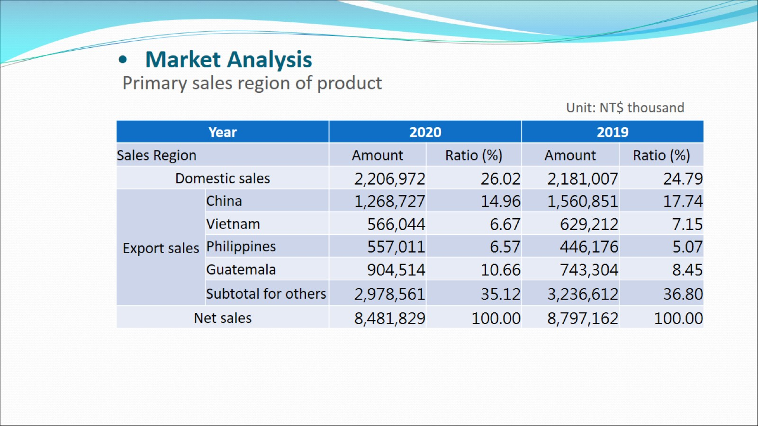
Market Analysis

Slide 8
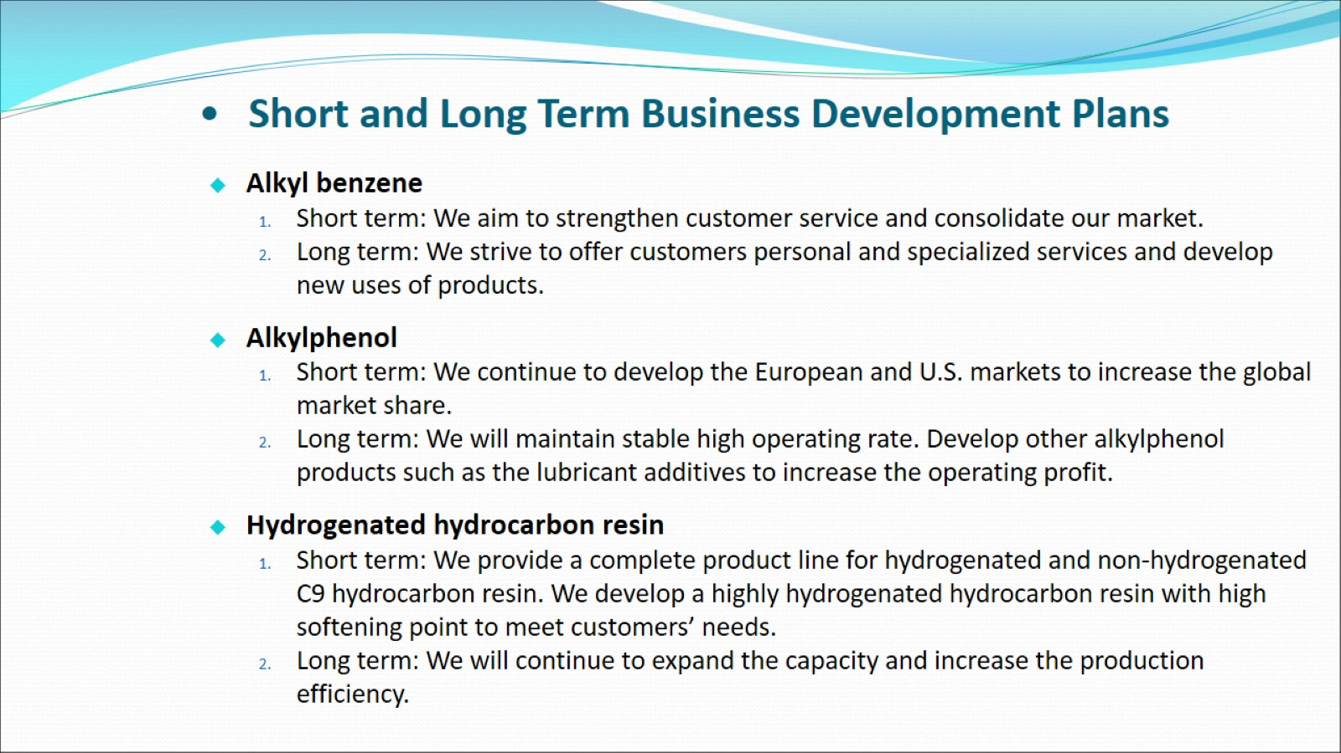
Short and Long Term Business Development Plans

Slide 9
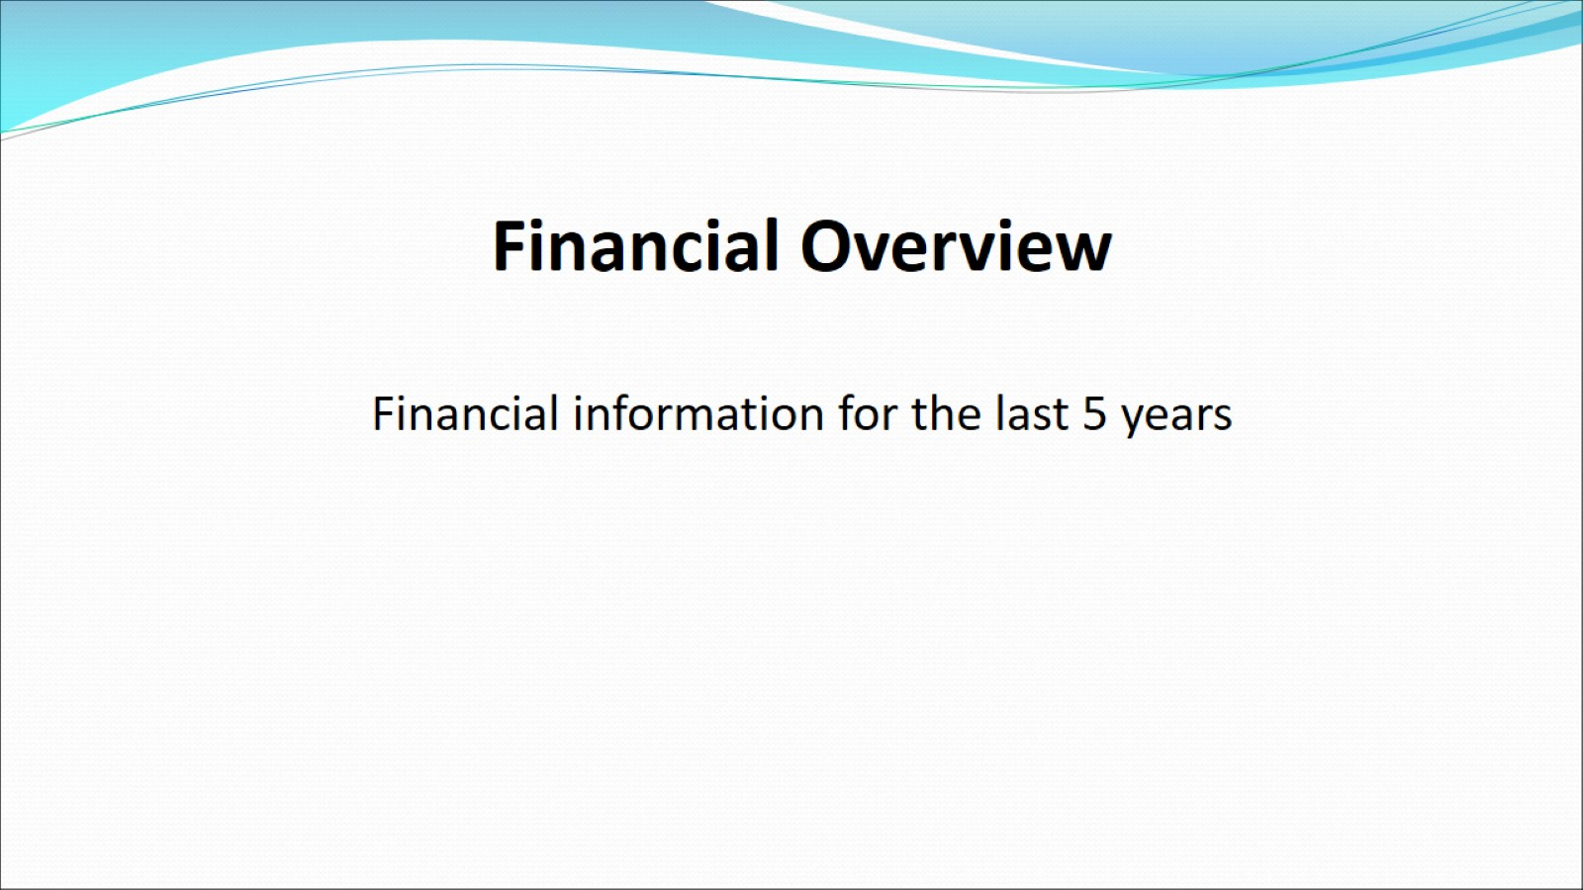

Slide 10
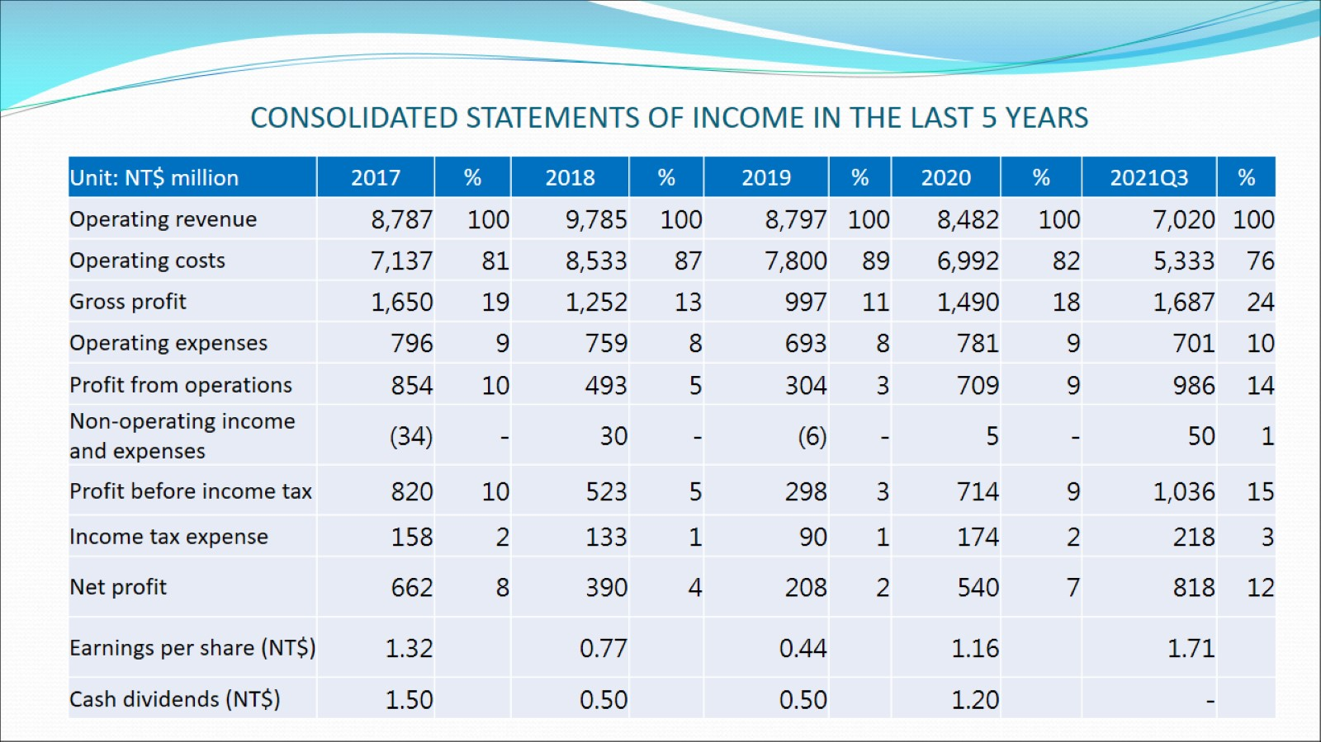
CONSOLIDATED STATEMENTS OF INCOME IN THE LAST 5 YEARS

Slide 11
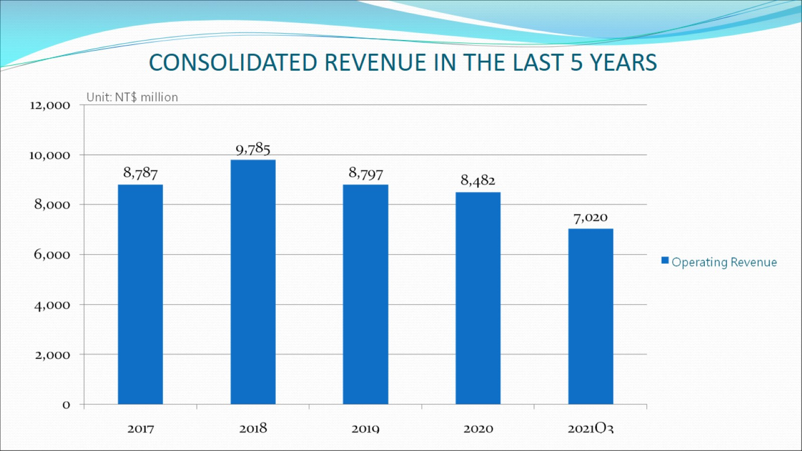
CONSOLIDATED REVENUE IN THE LAST 5 YEARS

Slide 12
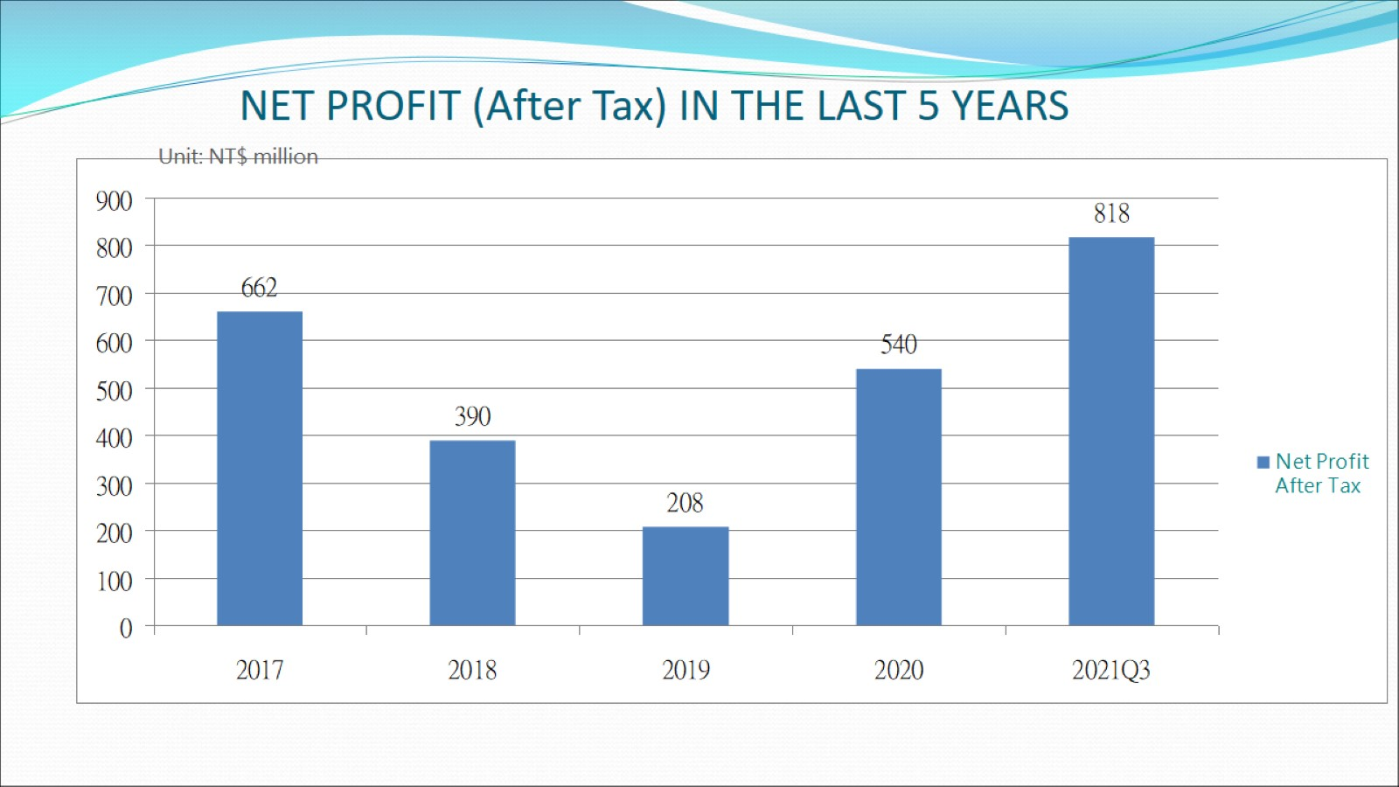
NET PROFIT (After Tax) IN THE LAST 5 YEARS

Slide 13
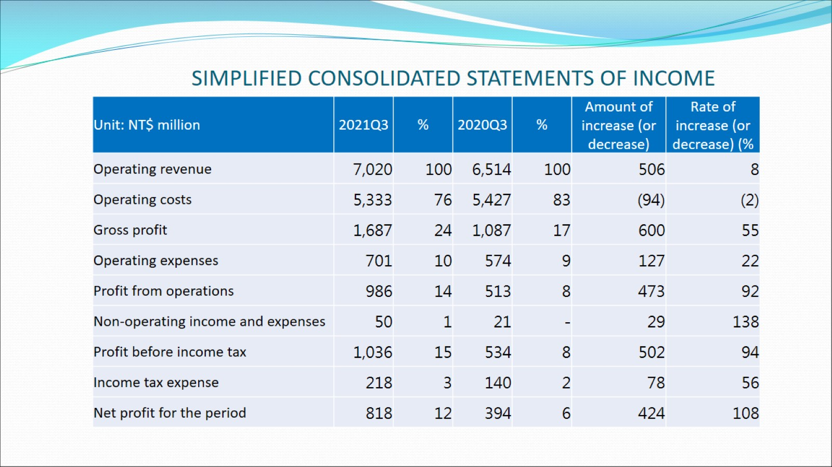
SIMPLIFIED CONSOLIDATED STATEMENTS OF INCOME

Slide 14
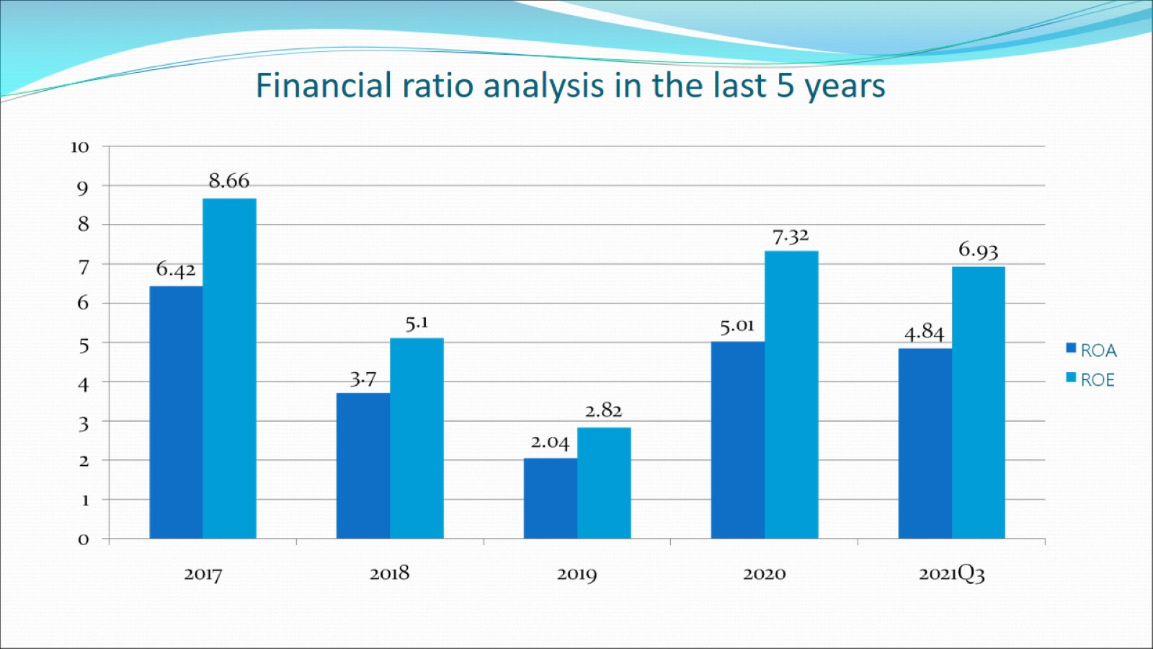
Financial ratio analysis in the last 5 years

Slide 15

Q&A

